Slide 1
Toward a Reduced-Form Factor Portfolio
TTIC 31220 Final Project Presentation
Kabir Sawhney and Joseph Denby
March 13, 2019

Slide 2
Motivation & Background
$$r_{i}= r_{f}+ β_{1}\left(r_{m} − r_{f}\right)+ β_{2}\left(SMB\right)+ β_{3}\left(HML\right)+ ε$$
Different financial assets (stocks, bonds, etc.) are all influenced by a similar set of underlying risks (inflation, economic growth, etc.).
In finance theory, the returns on these assets can be modeled as a linear combination of the returns to these risks, plus an error term.
Some researchers have used linear PCA to derive a smaller set of risks that perform well in explaining equity returns. We sought to extend this work to non-linear dimensionality reduction.

Slide 3
Description of Data
Our data was monthly returns from 1963 to 2013.
For our response variable, stock returns, we used the S&P 500 and the five longest-tenured stocks in the Dow Jones Industrial Average (ExxonMobil, Procter & Gamble, United Technologies, 3M, and IBM).
For the risks, we used a set of factor strategies developed by Novy-Marx and Velikov. They collected the returns to rules-based strategies designed to provide exposure to different factors.
We compared our results with the most popular theoretically-constructed risk factor portfolio, the Fama-French three-factor model.

Slide 4
Methodology
Split the data into training, validation, and test sets in time.
Tune hyperparameters for linear PCA, kernel PCA (with the polynomial and RBF kernels), Isomap, and Laplacian eigenmap.
Choose the best-performing non-linear dimensionality reduction methods.
Use the learned representation to fit a linear regression model.
Compare performance on the test set with linear PCA and the Fama-French model.

Slide 5
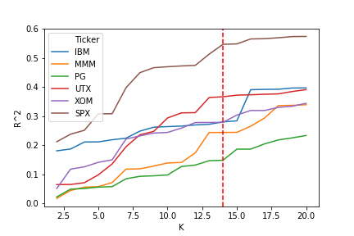
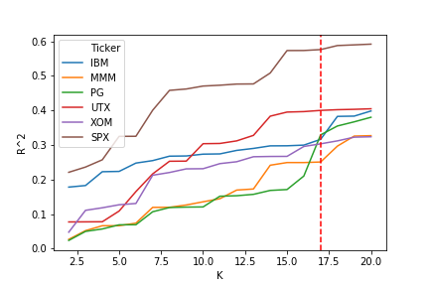
Results: Method Selection & Tuning
Tuning Number of Components for Kernel PCA
(RBF Kernel, Gamma = 1x10⁻⁴)
Tuning Number of Components for Linear PCA

Slide 6
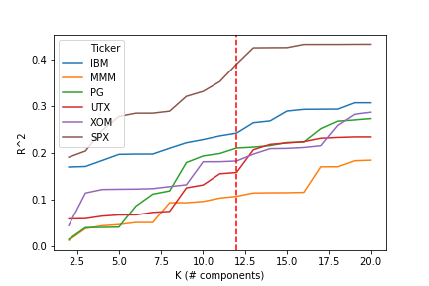
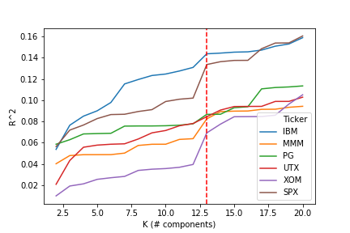
Results: Method Selection & Tuning
Tuning Number of Components for Isomap
(kNN graph, nearest neighbors = 24)
Tuning Number of Components for Spectral Embedding (kNN graph, nearest neighbors = 6)

Slide 7
Results: Explanation of Returns

Slide 8
Conclusions & Future Work
For explaining individual stock returns, non-linear dimensionality reduction methods don’t offer an improvement over standard linear PCA. This result suggests that the perspective that asset returns are a linear combination of returns to risk factors is broadly accurate.
None of our learned representations performed better than the Fama-French model, except for one stock (Procter & Gamble). However, it’s hard to make a general conclusion, as this result might have been different if we used a different set of underlying factors.
Future work could include doing the same analysis on different factor and/or response data, and using daily instead of monthly returns.

Slide 9
Questions?

